Slide 1

FLIGHT PRICE
PREDICTION
PROJECT
Submitted By :
Naveen

Slide 2
Introduction
Anyone who has booked a flight ticket knows how unexpectedly the prices vary. The cheapest available ticket on a given flight gets more and less expensive over time. This usually happens as an attempt to maximize revenue based on
1. Time of purchase patterns (making sure last-minute purchases are expensive)
2. Keeping the flight as full as they want it (raising prices on a flight which is filling up in order to reduce sales and hold back inventory for those expensive last-minute expensive purchases) So, you have to work on a project where you collect data of flight fares with other features and work to make a model to predict fares of flights.

Slide 3
Conceptual Background of the domain problem
First of all we should be knowing how to scrap the required data from various websites through the techniques of webscrapping, In order to do that we should extract all the urls of each car using relevant xpaths , we should be knowing how to build a linear regression model through collected data.
Literature Review
To get the enough amount of relevant data we have to crawl through Google to get perfect website, In that process we ended up landing in yathra.com,phone phe
We have listed out 6 such websites from which we can get the adequate information, They are as follows goibibo,travolook,cleartrip,ixigo,yathra,makemytrip

Slide 4
Mathematical and Analytical understanding of the problem
The data we collected was in in terms of rows and columns, there are 10 columns and 1558 rows out of which 3 columns where of object type and remaining are float and integer type, so in order to make the machine understands this we have to convert the categorical value to numerical values we accomplish it through label encoding or one hot encoding.
We did scaling of the dataset in order to have values of variables within certain limits so that machine can perform better, for this purpose we used different types of scaling namely standard scaling, min max scaling and Robust scaler, later we reduce the skewness using various techniques.
Hardware and tools used
Hardware : We used the hardware of 8GB RAM,1Tb ROM and i5 processor.
Software : For better visualization we used Tableau Public, Jupyter notebook from anaconda navigator for coding and webscrapping and Microsoft word and Power Point Presentation for creating the report and making the presentation respectively.

Slide 5
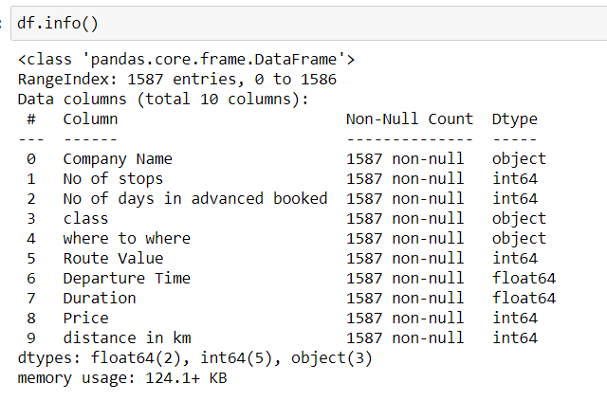
Data Source and their format
The major portion of the data we collected from car trade.com , there are 10 major parameters and 1558 rows out which 3 are of object type column and remaining's are of categorical type columns.

Slide 6
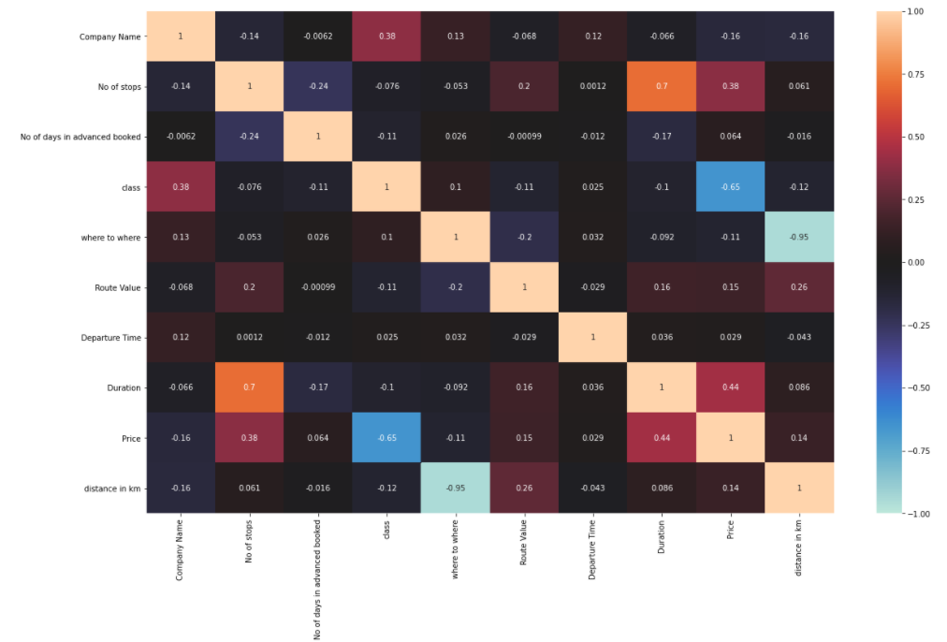
Results of Exploratory Data Analysis
The following are the interpretation we got from data analysis, For analyzing the data we took the help of data visualization libraries like seaborn, Matplotlib, plotly,Tableau software, First we drew the correlation and heatmaps from which we came to know which are the significant variables which decides the second hand car price.

Slide 7
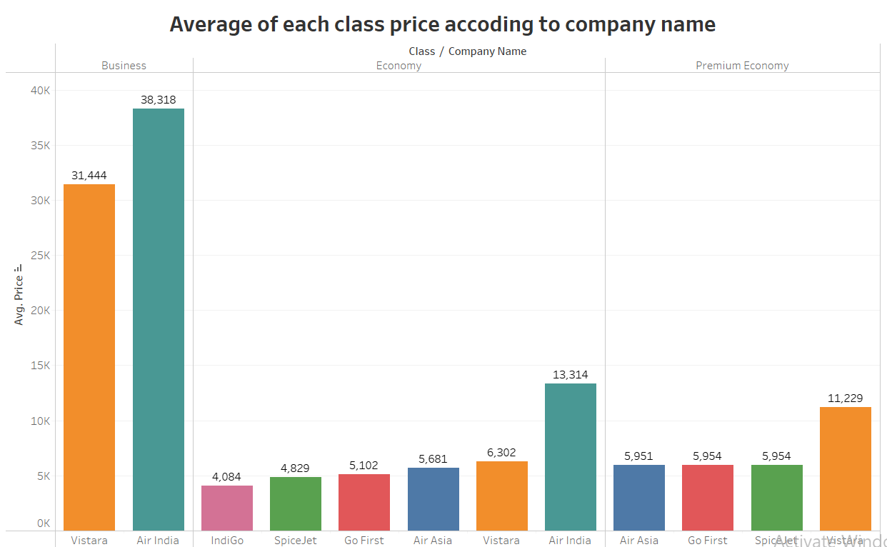
1. Average of each class price based on company name
The above graphs clearly indicates that if you want to travel in Business class choose vistara it has least average price,and for Economy class choose IndiGo, and for Premium Economy go for Air Asia.

Slide 8
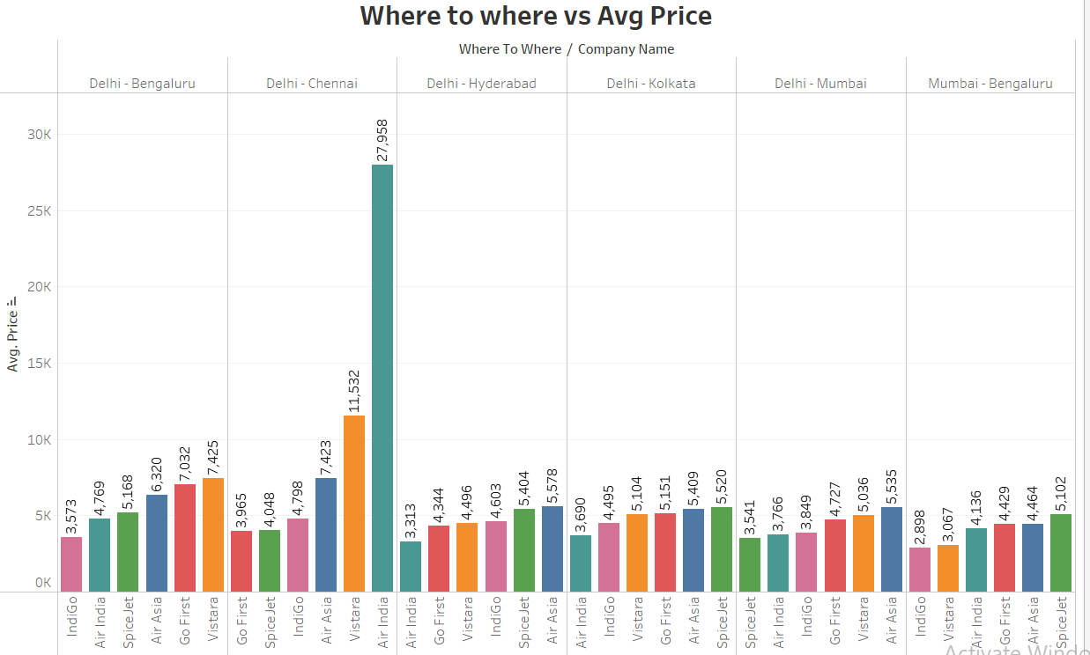
2. What’s the least price to travel from Delhi and Mumbai to other locations in Economy class

Slide 9
If you want to travel from Delhi to Bengaluru in Economy class then IndiGo will offer least price followed by Air India and SpaceJet and Vistara is the costly one.
If you want to travel from Delhi to Chennai in Economy class then Go First will offer least price followed by SpaceJet and IndiGo and Air India is the costly one.
If you want to travel from Delhi to Hyderabad in Economy class then Air India will offer least price followed by GoFirst and Vistara and Air Asia is the costly one.
If you want to travel from Delhi to Kolkata in Economy class then Air India will offer least price followed by IndiGO and Vistara and SpaceJet is the costly one.
If you want to travel from Delhi to Mumbai in Economy class then SpaceJet will offer least price followed by Air India and IndiGo and Air Asia is the costly one.
If you want to travel from Mumbai to Bengaluru in Economy class then IndiGo will offer least price followed by Vistara and Air India and SpaceJet is the costly one.

Slide 10
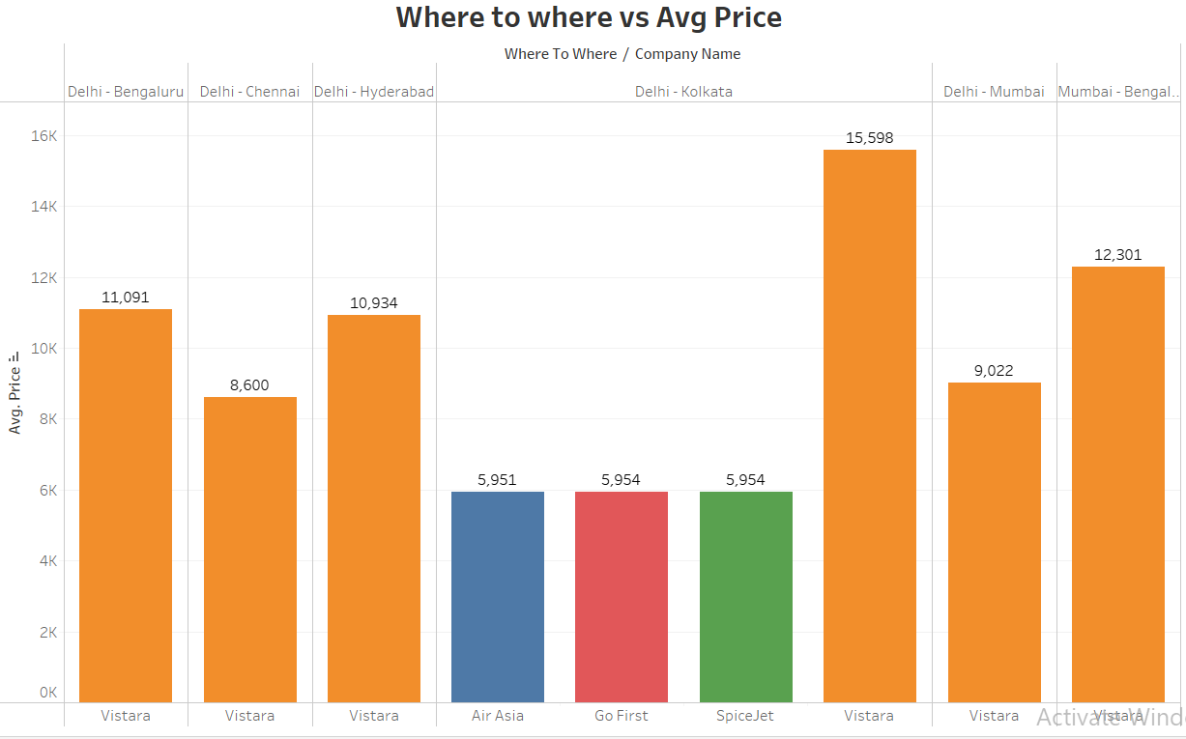
3.What’s the least price to travel from Delhi and Mumbai to other locations in Premium Economy class
If you want to travel from Delhi to Bengaluru in PremiumEconomy class then Vistara is the best choice
If you want to travel from Delhi to Chennai in Premium Economy class then Vistara is the best choice
If you want to travel from Delhi to Hyderabad in Premium Economy class then Vistara
If you want to travel from Delhi to Kolkata in Premium Economy class then Air Asia is the cheapest one followed by GoFirst and SpiceJet
If you want to travel from Delhi to Mumbai and Mumbai to Bengaluru in Premium Economy class then Vistara is the best choice.

Slide 11
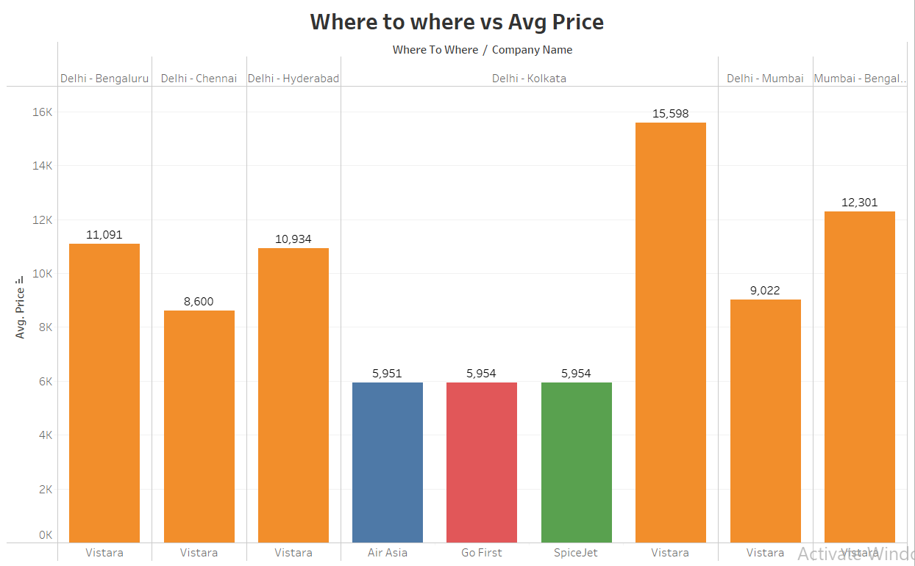
4.What’s the least price to travel from Delhi and Mumbai to other locations in Business class
If you want to go from Delhi to Bengaluru Chennai or Hyderabad or Mumbai or Mumbai to Bengaluru then vistara is the only available as per this data at this moment, It may vary on coming days.
If you want to go from Delhi to Kolkata in Business class then Air Asia is the cheapest one followed by GoFirst and SpaceJet and Vistara is the costliest one according to this data.

Slide 12
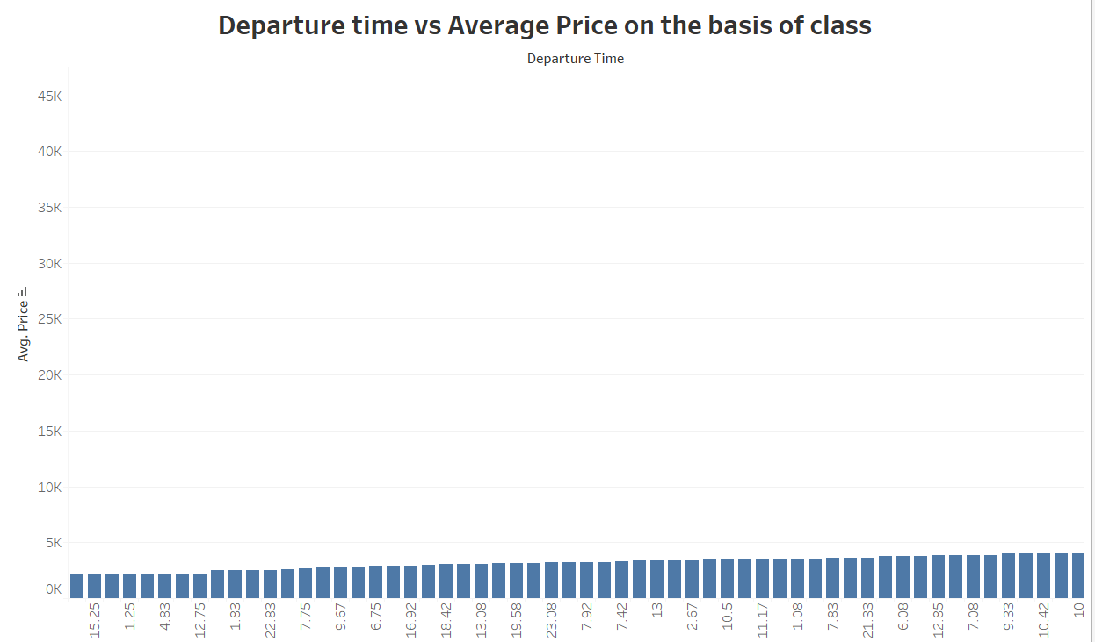
5. What’s the general departure time at which Economy class will have low price comparatively?
The above graph depicts that if you want to book for Economy class then if you choose 4am-5am in morning you have maximum chance that your booking price will be lowest in that whole day.
The highest price is generally observed for Economy class is around 3-5pm.
For premium economy class the least price observed around 11am to 12pm and costly price is observed between 3pm -4 pm
For Business class the least price observed around 11am to 12pm and costly price is observed between 3pm -4 pm

Slide 13
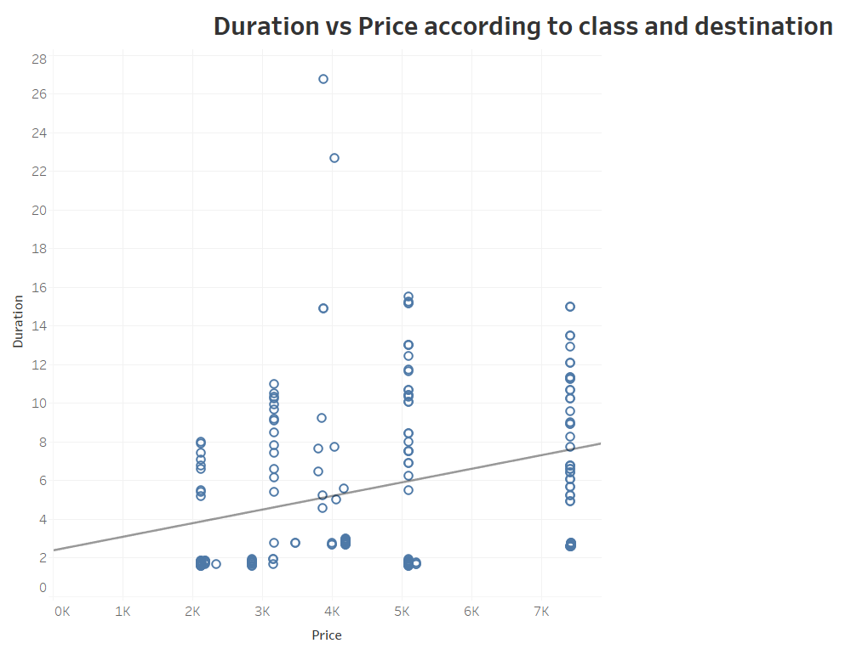
6.How duration and price are related based on class and destination?
From the above graph we can clearly see that as duration increases the price is also going to be increased.

Slide 14
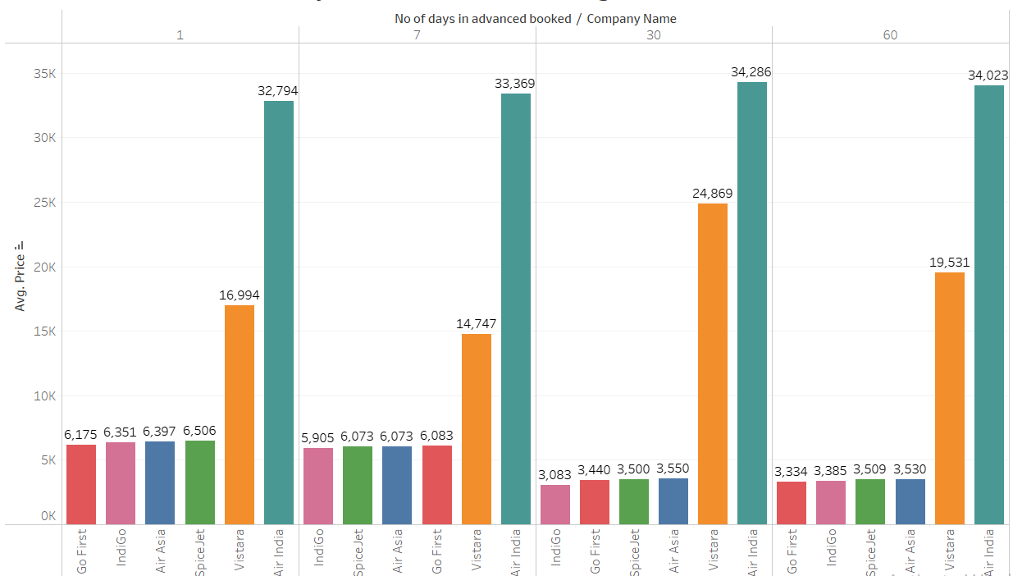
7. How advanced booking affects the price of the ticket?
If you book any ticket in an advance of 7 days you will be profited by 4.37% of cost of booking one day in advance
If you book any ticket in an advance of 30 days you will be profited by 51% of cost of booking one day in advance
There won’t be much difference if you book 30 or 60 days in advanced.

Slide 15
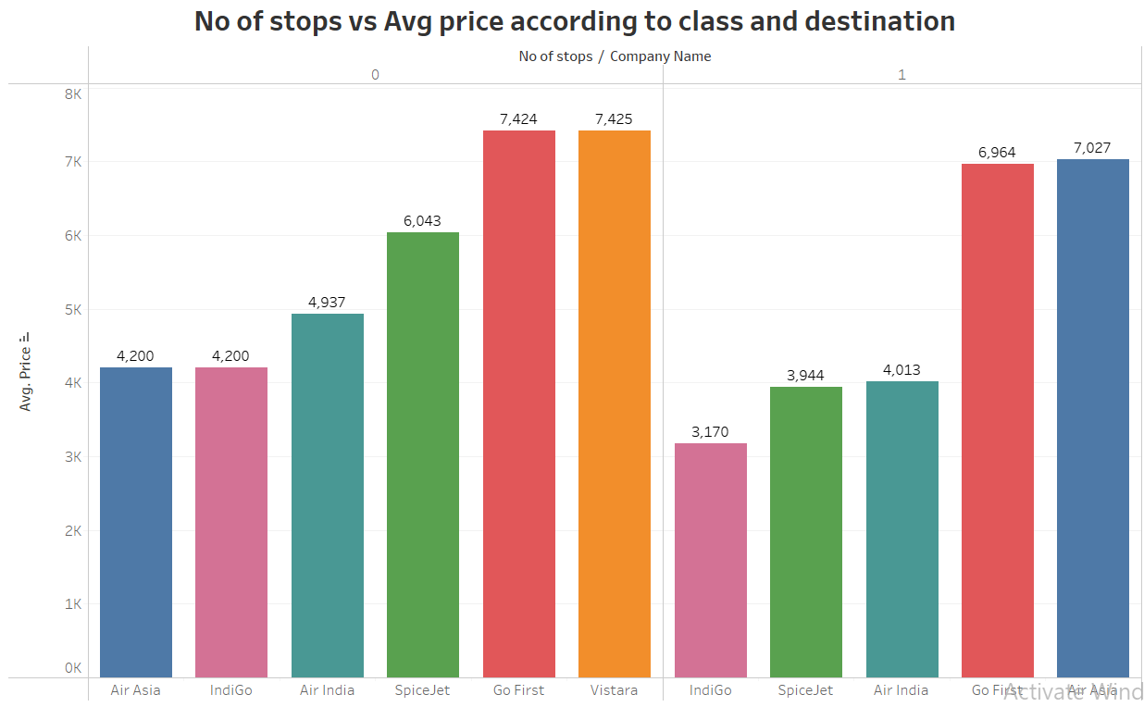
8. How number of stops varies the price of the ticket to the same destination?
On an average if there is one stops the ticket price will drop by 24% of the cost of ticket without any stop.

Slide 16
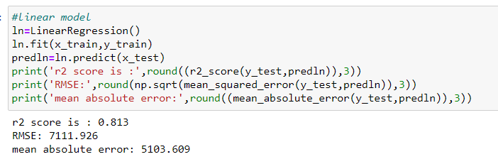
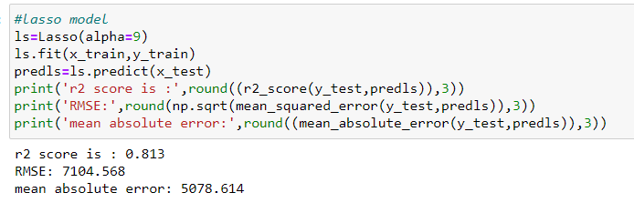
Model Building
We have used several linear regression models to evaluate and finalize the best models, The major models we have used as follows.
1.Linear Regression
2.Lasso Regression model

Slide 17
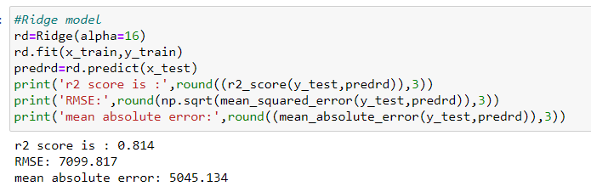
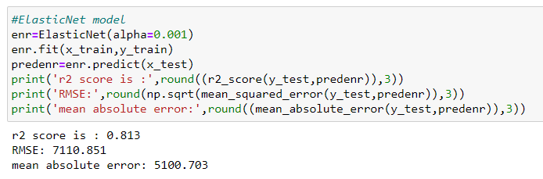
3.Ridge Regression
4.Elasticnet Regression

Slide 18
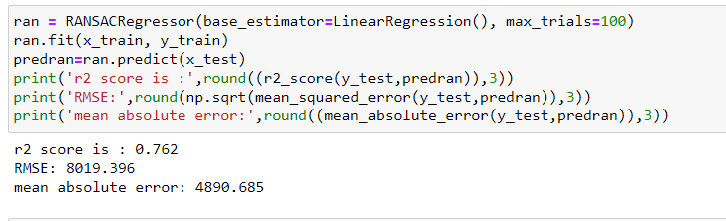
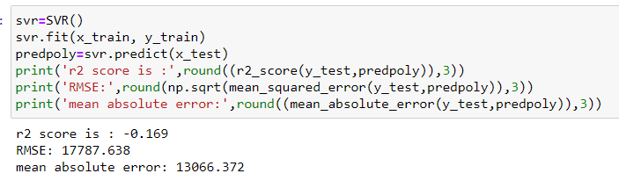
5.Ransac Regressor
6.Support Vector Regressor

Slide 19
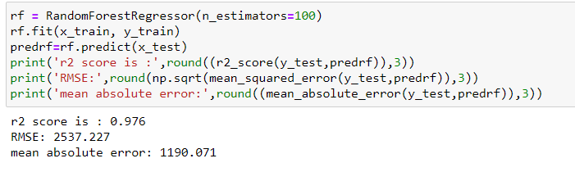
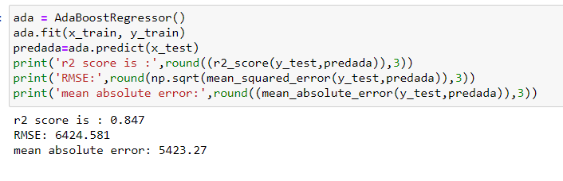
7.Random Forest Regressor
8.AdaBoost Regressor

Slide 20
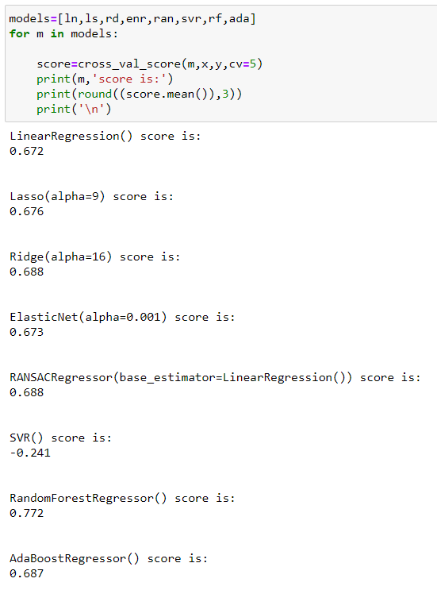
Cross Validation Score
The difference between accuracy and cross validation is less for random forest regressor, so it is the best model

Slide 21
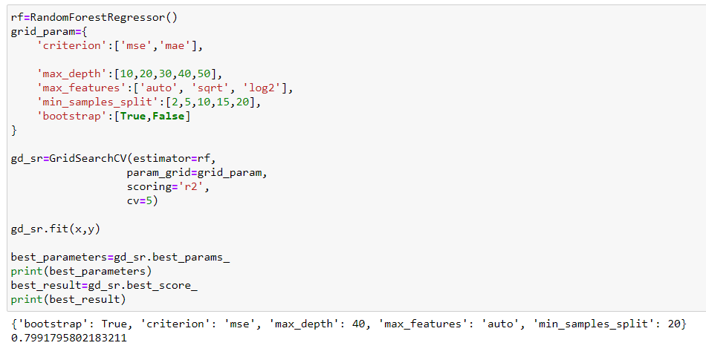
Hyper Parameter Tuning
Final Accuracy

Slide 22
Key findings and the conclusions of the study
Based on the above key findings we would like to give some prescription for our client
if you want to travel in Business class choose vistara it has least average price,and for Economy class choose IndiGo, and for Premium Economy go for Air Asia.
• If you want to travel from Delhi to Hyderabad in Economy class then Air India will offer least price followed by GoFirst and Vistara and Air Asia is the costly one.
• If you want to travel from Delhi to Kolkata in Economy class then Air India will offer least price followed by IndiGO and Vistara and SpaceJet is the costly one.
• If you want to travel from Delhi to Mumbai in Economy class then SpaceJet will offer least price followed by Air India and IndiGo and Air Asia is the costly one.
• If you want to travel from Mumbai to Bengaluru in Economy class then IndiGo will offer least price followed by Vistara and Air India and SpaceJet is the costly one.
• If you want to travel from Delhi to Bengaluru in PremiumEconomy class then Vistara is the best choice
• If you want to travel from Delhi to Chennai in Premium Economy class then Vistara is the best choice

Slide 23
• If you want to travel from Delhi to Hyderabad in Premium Economy class then Vistara
• If you want to travel from Delhi to Kolkata in Premium Economy class then Air Asia is the cheapest one followed by GoFirst and SpiceJet
• If you want to travel from Delhi to Mumbai and Mumbai to Bengaluru in Premium Economy class then Vistara is the best choice.
• If you want to go from Delhi to Bengaluru Chennai or Hyderabad or Mumbai or Mumbai to Bengaluru then vistara is the only available as per this data at this moment, It may vary on coming days.
• If you want to go from Delhi to Kolkata in Business class then Air Asia is the cheapest one followed by GoFirst and SpaceJet and Vistara is the costliest one according to this data.
• The above graph depicts that if you want to book for Economy class then if you choose 4am-5am in morning you have maximum chance that your booking price will be lowest in that whole day.
• The highest price is generally observed for Economy class is around 3-5pm.
• For premium economy class the least price observed around 11am to 12pm and costly price is observed between 3pm -4 pm
• For Business class the least price observed around 11am to 12pm and costly price is observed between 3pm -4 pm
• From the above graph we can clearly see that as duration increases the price is also going to be increased.

Slide 24
Thank you

